Slide 1


Phase Engineered Atomically thin high-K
Dielectrics for 2D Electronics
Sagar Paudel
Wayne State University
Physics & Astronomy

Slide 2
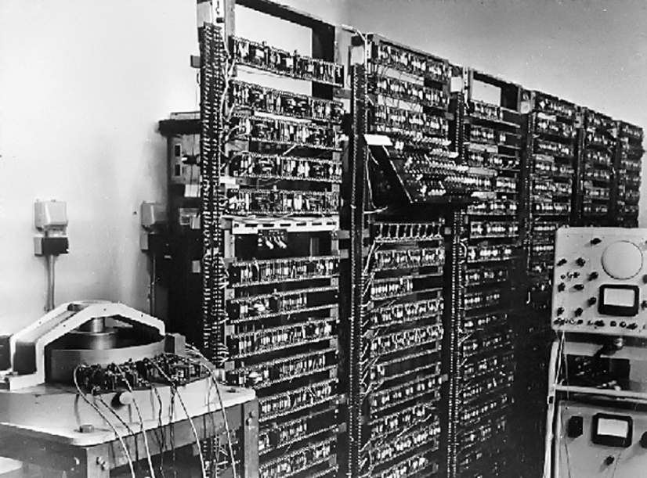
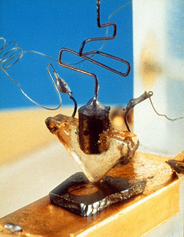
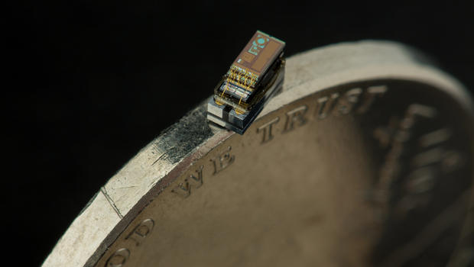
Introduction:
First Transistor
used computer 1953
Michigan Micro
Mote (M^3)
2015
First Transistor 1947
Size of transistor decreased from 10 µm in 1970’s to submicron level nowadays
Development of Silicon based devices took the central focus
Two dimensional materials like Graphene attracted lot of interest

Slide 3
Graphene
Strong in-plane bond and weak inter-layer force
Uniform surface
Free from Dangling bonds
Stable at room temp
High Mobility
10⁶cm²v⁻¹s⁻¹ at 2K
10⁵ cm² v⁻¹s⁻¹ room temp
Elac D.C.(2011)
Zero band gap
Notes:
Applications of 2D : FETs, Optoelectronic devices, Topological insulators, electrocatalysts.
Landau (1937) and Peierls (1935) argued that strictly 2D crystals were
thermodynamically unstable and could not exist.

Slide 4
Graphene Like 2D material :
Transitional Metal Dichalcogenides
(TMD)
Graphene like material with finite band gap
Thermally stable
Compatible
Excellent on-off ratio > 10⁶

Slide 5
MoS2 FET
Field effect mobility of MoS2 (8-40 nm) is found in tens of cm² /Vs and on-off ratio higher than 10⁵ .
Anthony Ayari et al., (2007)
The mobility for the single layer MoS₂ FET on SiO₂ is found in the range 0.1 – 10 cm²/Vs.
B. Radisavljevic et. al.,(2011)
The mobility of bi-layer MoS₂ FET were extracted 10-15 cm²/Vs.
Han Wang et. al., (2012)
Room temperature mobility 50-200 cm²/Vs for bulk MoS₂.
R. Fivaz et.al., (1967)

Slide 6
Challenges of MoS2 FET
Contact
Interface
High K dielectric integration
In our study, we will be focusing on High K dielectric integration of MoS₂ FET.

Slide 7
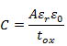
Why High K dielectric ?
Electrostatic control of channel is achieved through the capacitive coupling between the gate and the channel region
Scaling requires reduction in the source and drain depth by the same scaling factor as gate length, to ensure the effective control of channel.
Decreasing the thickness of gate oxide provides same result as thickness is inversely proportional to C.
Semi-conductor
Imaginary
capacitor
plate
Oxide
Metal

Slide 8
But ,
Decreasing the gate oxide thickness gives rise to short channel effects:
Increase in leakage current
Reduction In On-off ratio
Break down of gate oxide
Another Way,
Replacing SiO₂ by dielectric having high dielectric constant increases the capacitive coupling
Finding new dielectrics having high dielectric constant !!

Slide 9
Criteria Required
Good thermal stability
Low density of intrinsic defects
Sufficient gate dielectric lifetime
Sufficient energy band-gap

Slide 10
Possible Candidates
Source :Wu, M. et. Al., 2008

Slide 11
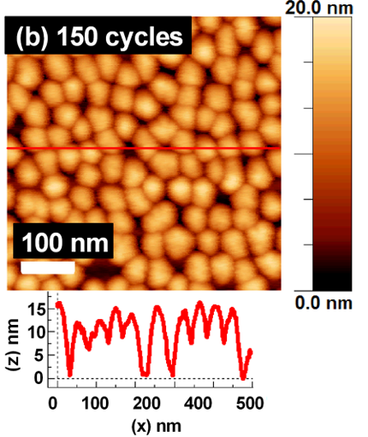
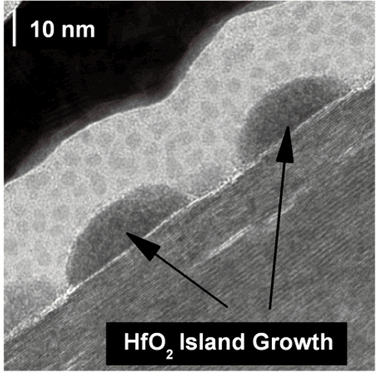
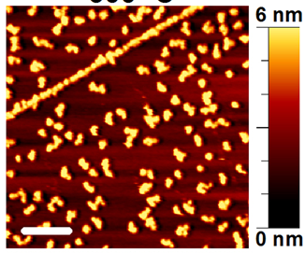
Problem in High K dielectric integration of TMD
AFM image of HfO2 on MoS2 surface by ALD
XPS image showing island type of growth
AFM image of Al2O3 deposited
by 30 ALD cycles on MoS2 .
Source: Azcati A et.al., 2014
Source : Stephen M. et. al., (2013)
They require complex growth process
Needs Surface treatment
Non-uniform deposition
Surface contamination

Slide 12
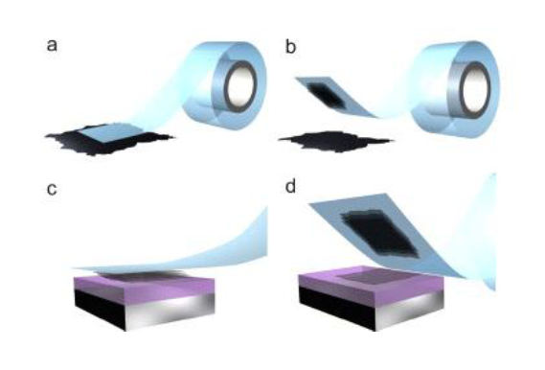
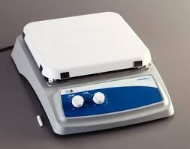
Solution
Two dimensional atomically flat high K dielectric obtained through mechanical exfoliation
substrate
300̊ C
3 hours
Exfoliation of TaS₂
Thermal Oxidation

Slide 13
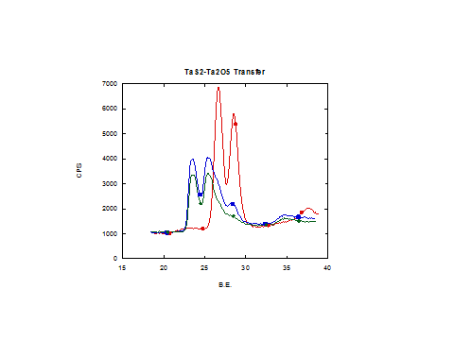
XPS Study of Oxidized TaS2 :
26.7 eV
28.6 eV
Source : Kuo Y., 1992
Area ratio = 1.4
The energy position of these peaks is close to the binding energy of Ta in stoichiometric Ta₂O₅.

Slide 14
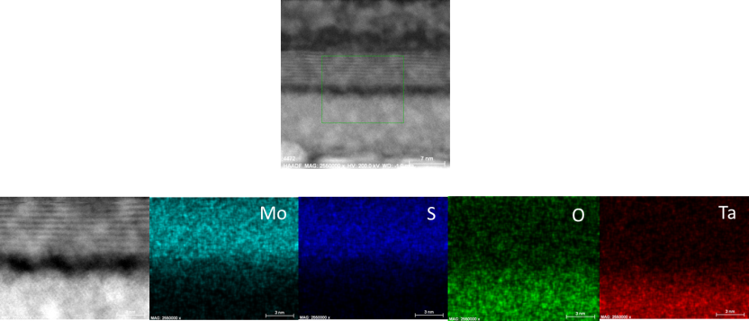
TEM Study
MoS2
Oxidized TaS2

Slide 15
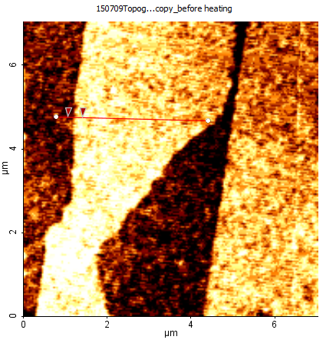
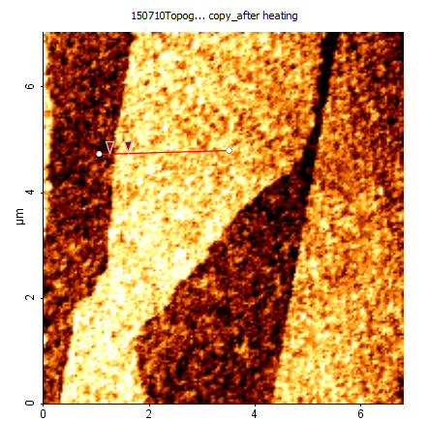
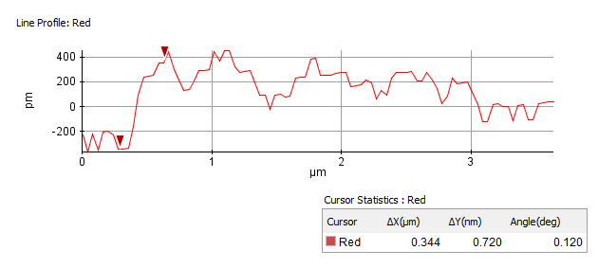
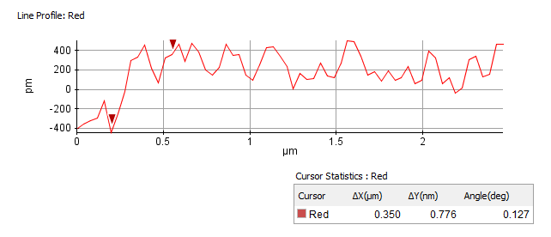
AFM Study :
Before heating
After heating

Slide 16
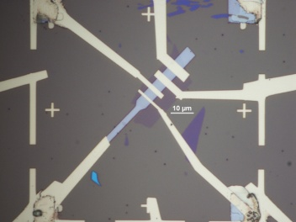

C-V Measurement :
Notes:
Thickness of sample 18nm

Slide 17
C-V Measurement (cont.) :
Using
We found:
K = 12.6

Slide 18
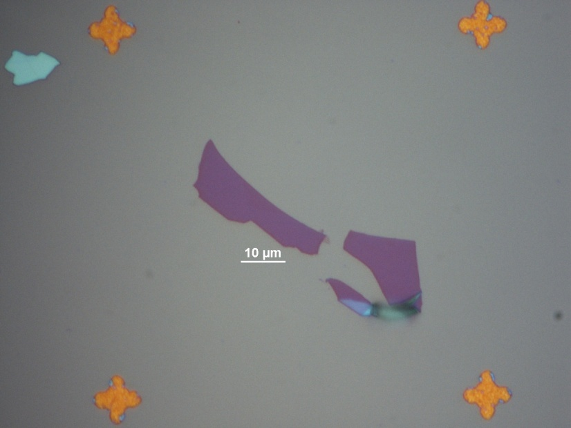
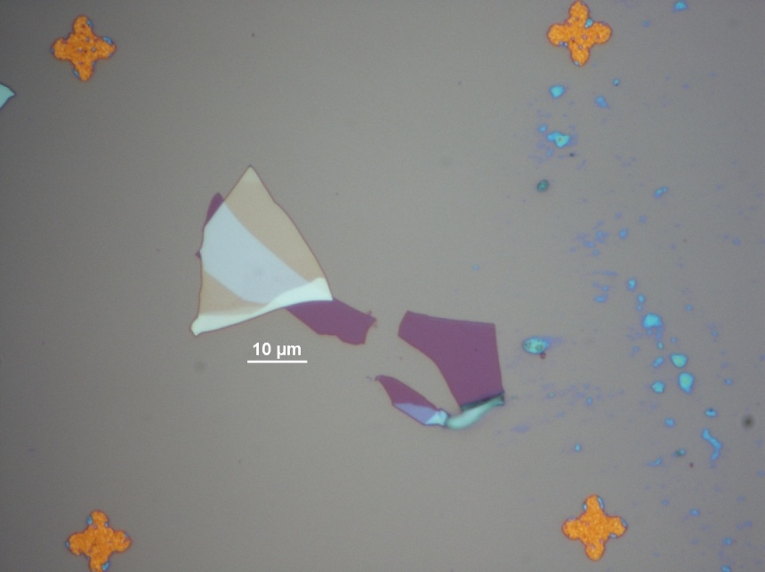
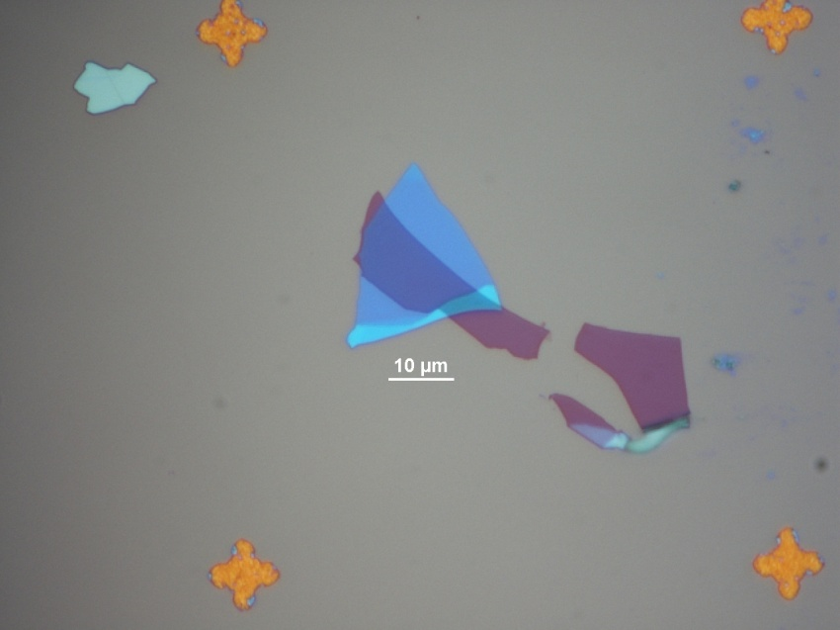
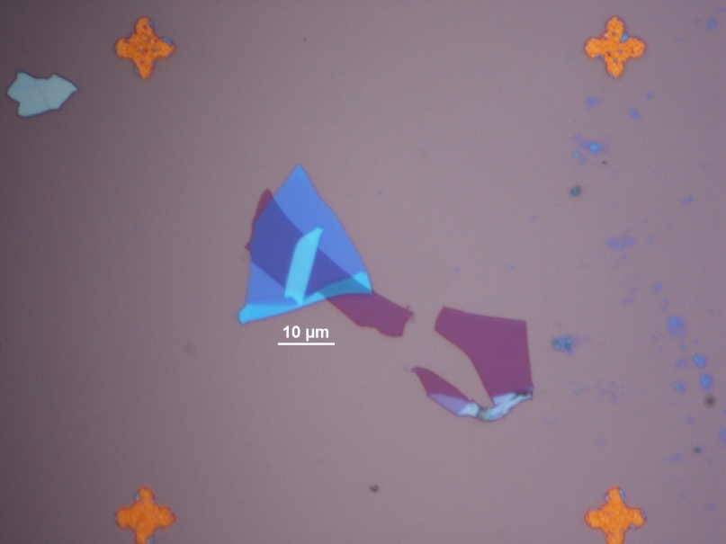
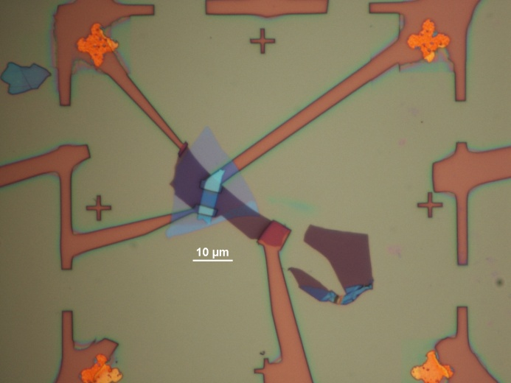
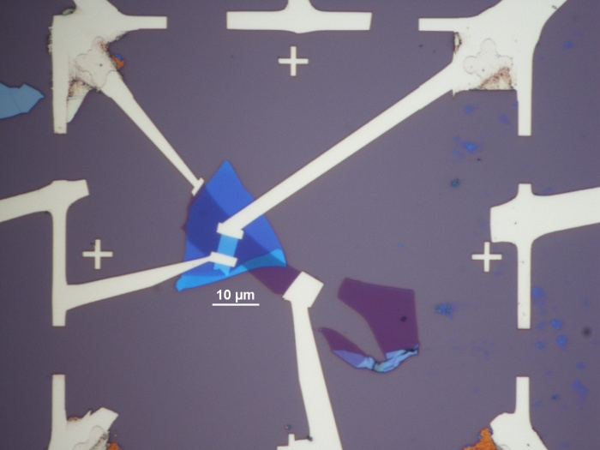
Experimental Details :
1. Graphene Transfer
2. TaS₂ Transfer
3. Oxidation
4. MoS2 Transfer
5. E-beam Lithography
6. Gold Deposition
Electrodes
MoS₂
Graphene
Ta₂O₅
Si-substrate

Slide 19
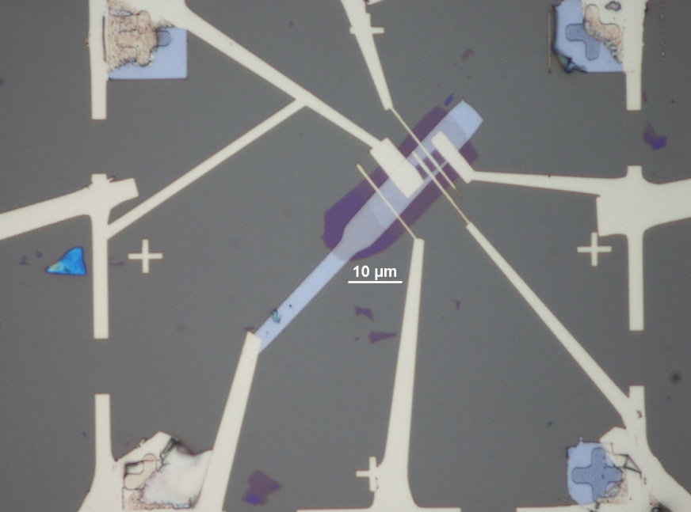
Platinum back-gate device :
MoS₂
Ta₂O₅
Platinum

Slide 20
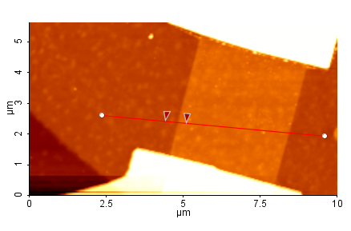
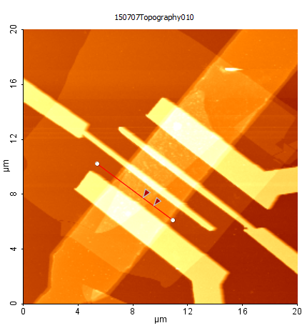
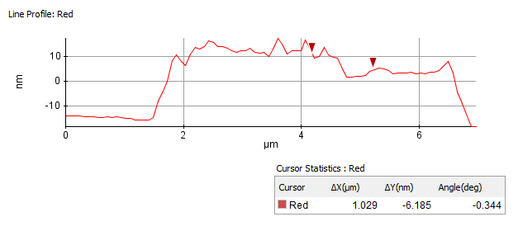
AFM Characterization :
Graphene back gate device
Platinum back gate device
Ta₂O₅
Platinum
Ta₂O₅
MoS₂
MoS₂
Gold Electrode
Grap
hene
Gold Electrode
Gr : 8 nm
Ta₂O₅ : 18 nm
MoS2 : 7 nm
Pt = 22 nm
Ta2O5 = 12 nm
MoS2 = 6 nm

Slide 21
Electrical Characterization
Graphene Back gate Device
Output Characteristics

Slide 22
Transfer Characteristic
a
b
Linear plot
Semi-log plot

Slide 23
Sub-threshold Swing
Sub-threshold swing = ∆x / ( Order of ∆y )
70 mV/decade ~ SS

Slide 24
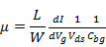
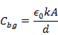
Mobility Calculation
µ ~ 55 cm²V⁻¹s⁻¹
Notes:
Length = 4.05 um
Width = 3.62 um

Slide 25
Hysteresis Behavior
Linear plot
Semi-log plot

Slide 26
Platinum Back gate device
Output Characteristic
Transfer Characteristic
100 mV/decade < SS
µ ~ 50 cm²V⁻¹s⁻¹

Slide 27
Future Works
Ta₂O₅ as Top Gate dielectric
Optimizing the Contacts with Graphene electrodes
Optimizing the thermal oxidation Process
Scaling of Dielectric thickness
Scaling of Channel length

Slide 28
Acknowledgements
Advisor : Dr. Zhixian Zhou
Committee Members :
Dr. Boris Nadgorny
Dr. Ashis Mukhopadhyay
Dr. Mark Ming-Cheng Cheng
Bhim Chamlagain, Quingsong Cui, Hsun Jen Chuang 'Ben',
Meeghage Perera.
Upendra, Kraig, Arthur, Prakash.

Slide 29

THANK YOU.

Slide 30
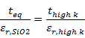
High K Dielectrics
t_{high K} = 10 nm
Ԑ_{r}, _{SiO2} = 3.9
Ԑ_{r}, _{Ta2O5} = 20
t_{eq} = 1.95 nm

Slide 31
AFM Characterization :
Ta₂O₅
Platinum
Ta₂O₅
MoS₂
MoS₂
Gold Electrodes
Graphene
Gold Electrode
Graphene Back gate device
Platinum Back gate device

Slide 32
AFM Study :
Before heating
After heating

